Slide 1
Research Computing Update
April 2021

Slide 2
HPC Resources
New HPC Procurement via ANKABUT
Continued delays to launch due to missing identity management system at KU. A way forward has been agreed and expect launch late June
Masdar Datacentre resources HPC Cluster
Big push to vacate Masdar Datacentre, though no solid date given.
Working with IT/Ankabut to vacate as soon as possible
SAN HPC Cluster
Quote for the decommissioning of hardware with ADNOC now, awaiting their decision. No update from ADNOC.

Slide 3
Research Computing Committee (RCC)
Held RCC meeting late April
Presented draft strategy and invited feedback and comments.
Presented proposed processes for creating accounts on new HPC, and received endorsement and feedback
Agreed that time on HPC will be accounted to individual Research Projects.
Was informed that Ovidiu Baltatu from the medical school will be leaving KU. Need to get new nomination from Dean of CMHS in due course.
Presentation and minutes will be uploaded to shared drive shortly
Next meeting to be scheduled in early June.

Slide 4
Resource Utilization

Slide 5
KU Cluster core distribution

Slide 6
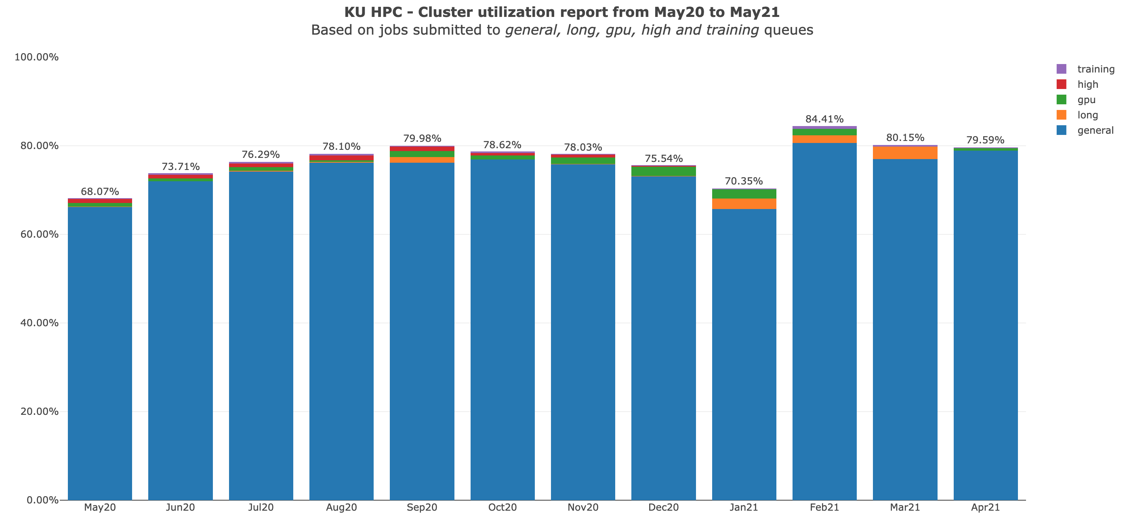

Slide 7
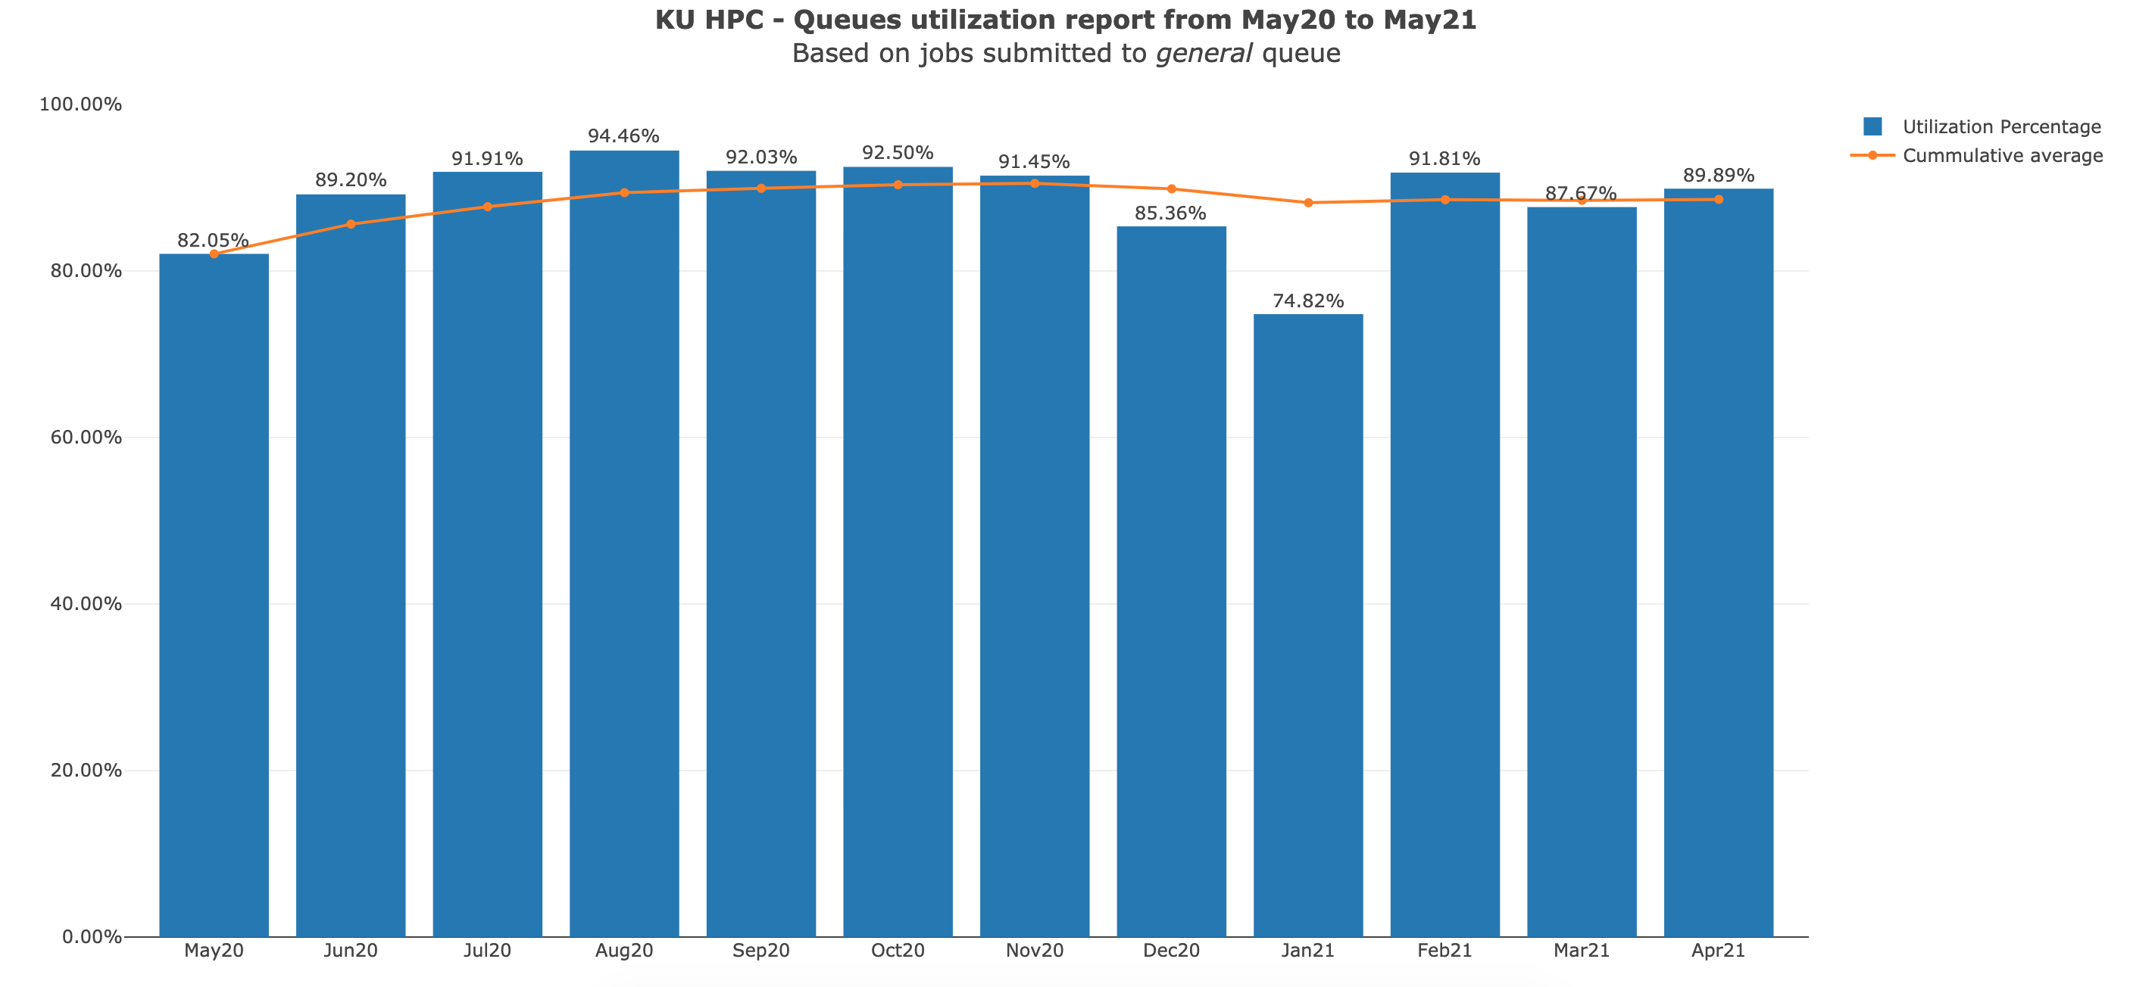

Slide 8
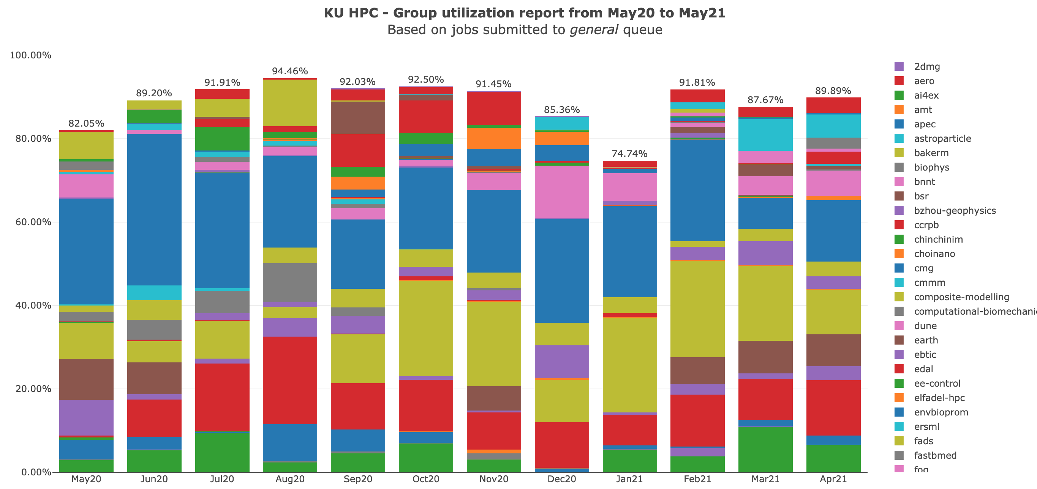

Slide 9
KU HPC Group Utilization for April 2021.
Groups were created under PI names, some of which have left KU, though the group remains. There is no link directly between HPC accounts and HR data. That is being worked on for the new cluster.

Slide 10
PI Cluster core distribution

Slide 11
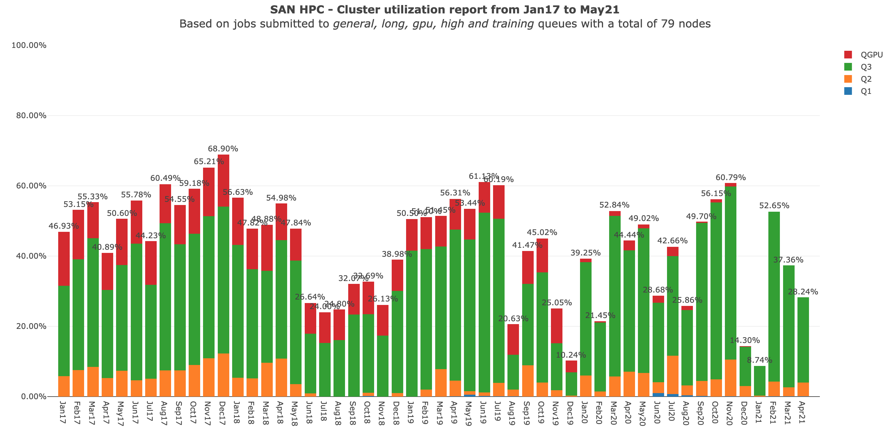

Slide 12
Status of KPI’s

